Slide 1
UITM web data extraction using tree-based technique
name : feadrick masdin
Id : 2016317277
Programme : cs2230
Supervisor name : rosslina Mohamed nawi

Slide 2
Project background
Academic programme
Web data extraction
Mobile application

Slide 3
Problem statement
It is such a hassle and time consuming when user search for a programme in UiTM by looking at different faculty website one by one.

Slide 4
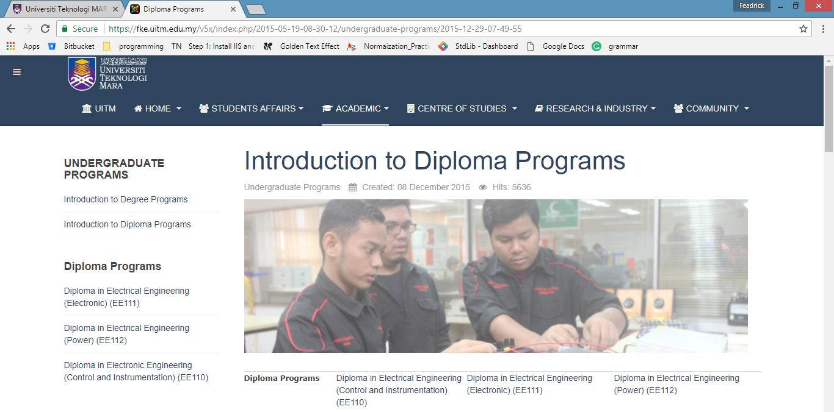
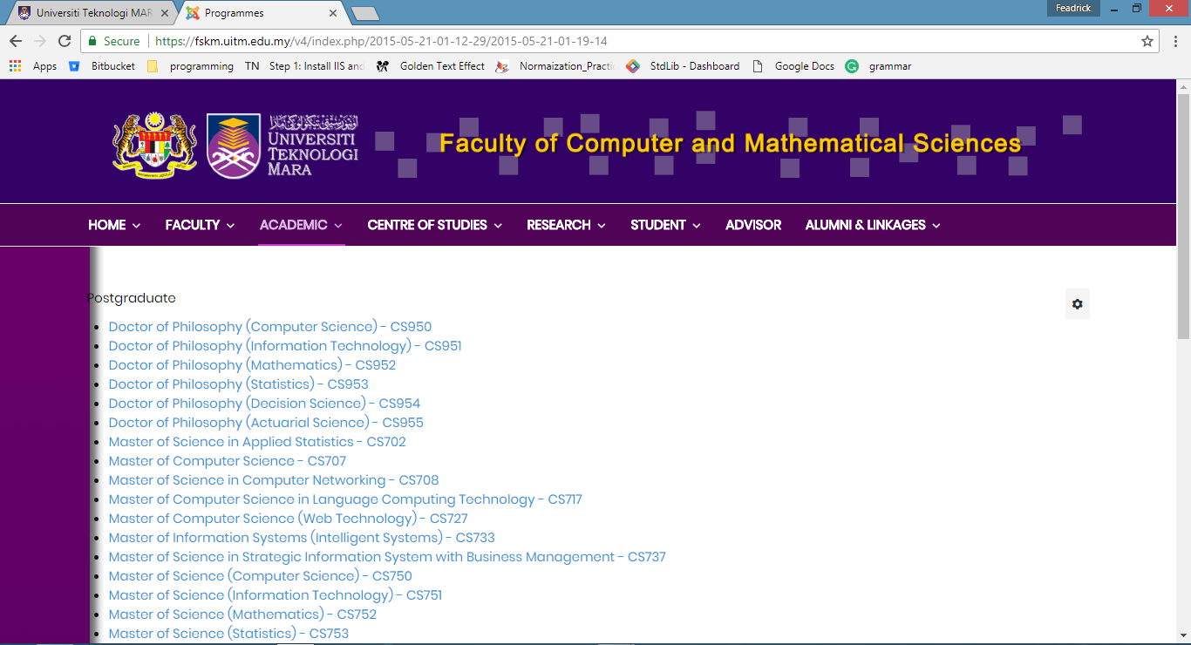
example
Faculty Of Electrical Engineering Academic programme information
Faculty of Computer and Mathematical Sciences Academic programme information

Slide 5
Objectives
To identify the techniques that used to extract the information from different website
To develop mobile application that display the information academic programme
To evaluate the functionality of the mobile application

Slide 6
Project scope
.net core library v2.0
Xamarin
Cross platrofm mobile application
android (v 4.0 until v 8.1 )
ios( v7.0 until v11.4)

Slide 7
Web data Extraction techniques
Tree based approach
Xpath expression
Tree edit distance matching
simple tree matching
Weighted tree matching
Web wrapper approach
Regular expression based approach
Logic based approach
Partial tree alignment
Machine learning approach
Hybrid aka learning based wrapper generation
Template based matching
Spatial reasoning

Slide 8
Project significance
Ease prospective student to find information about academic programme offered by uitm
Save the time of prospective student to find the information

Slide 9
Literature review
Web data extraction
Mobile application
(Emilio De Mio,2014)
(Fahad islam,2016)
(john Benderskey,2015)
(Inmaculada Ayala,2017)
(Shuangyang li,2016)

Slide 10
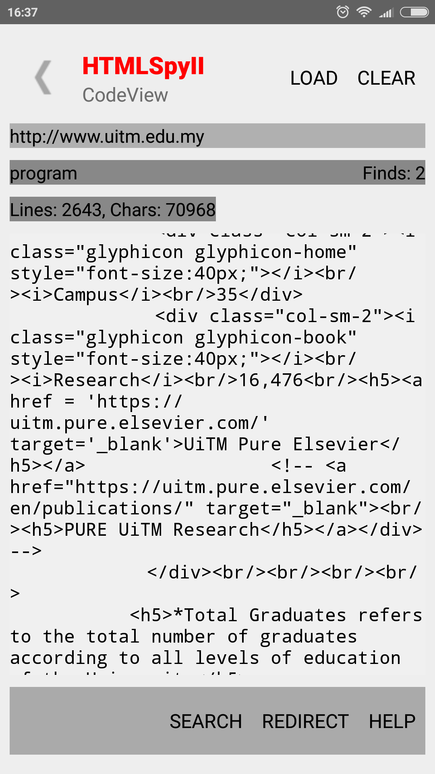
Similar application
Use regular expression to extract data from web site
Use jsoup library
Use web wrapper approach
Advantage
Able to select specific text on html source code
Provide different view
Jsoup view
Code view
ftp view
Web view
Disadvantage
Cant extract the specific tag on html document

Slide 11
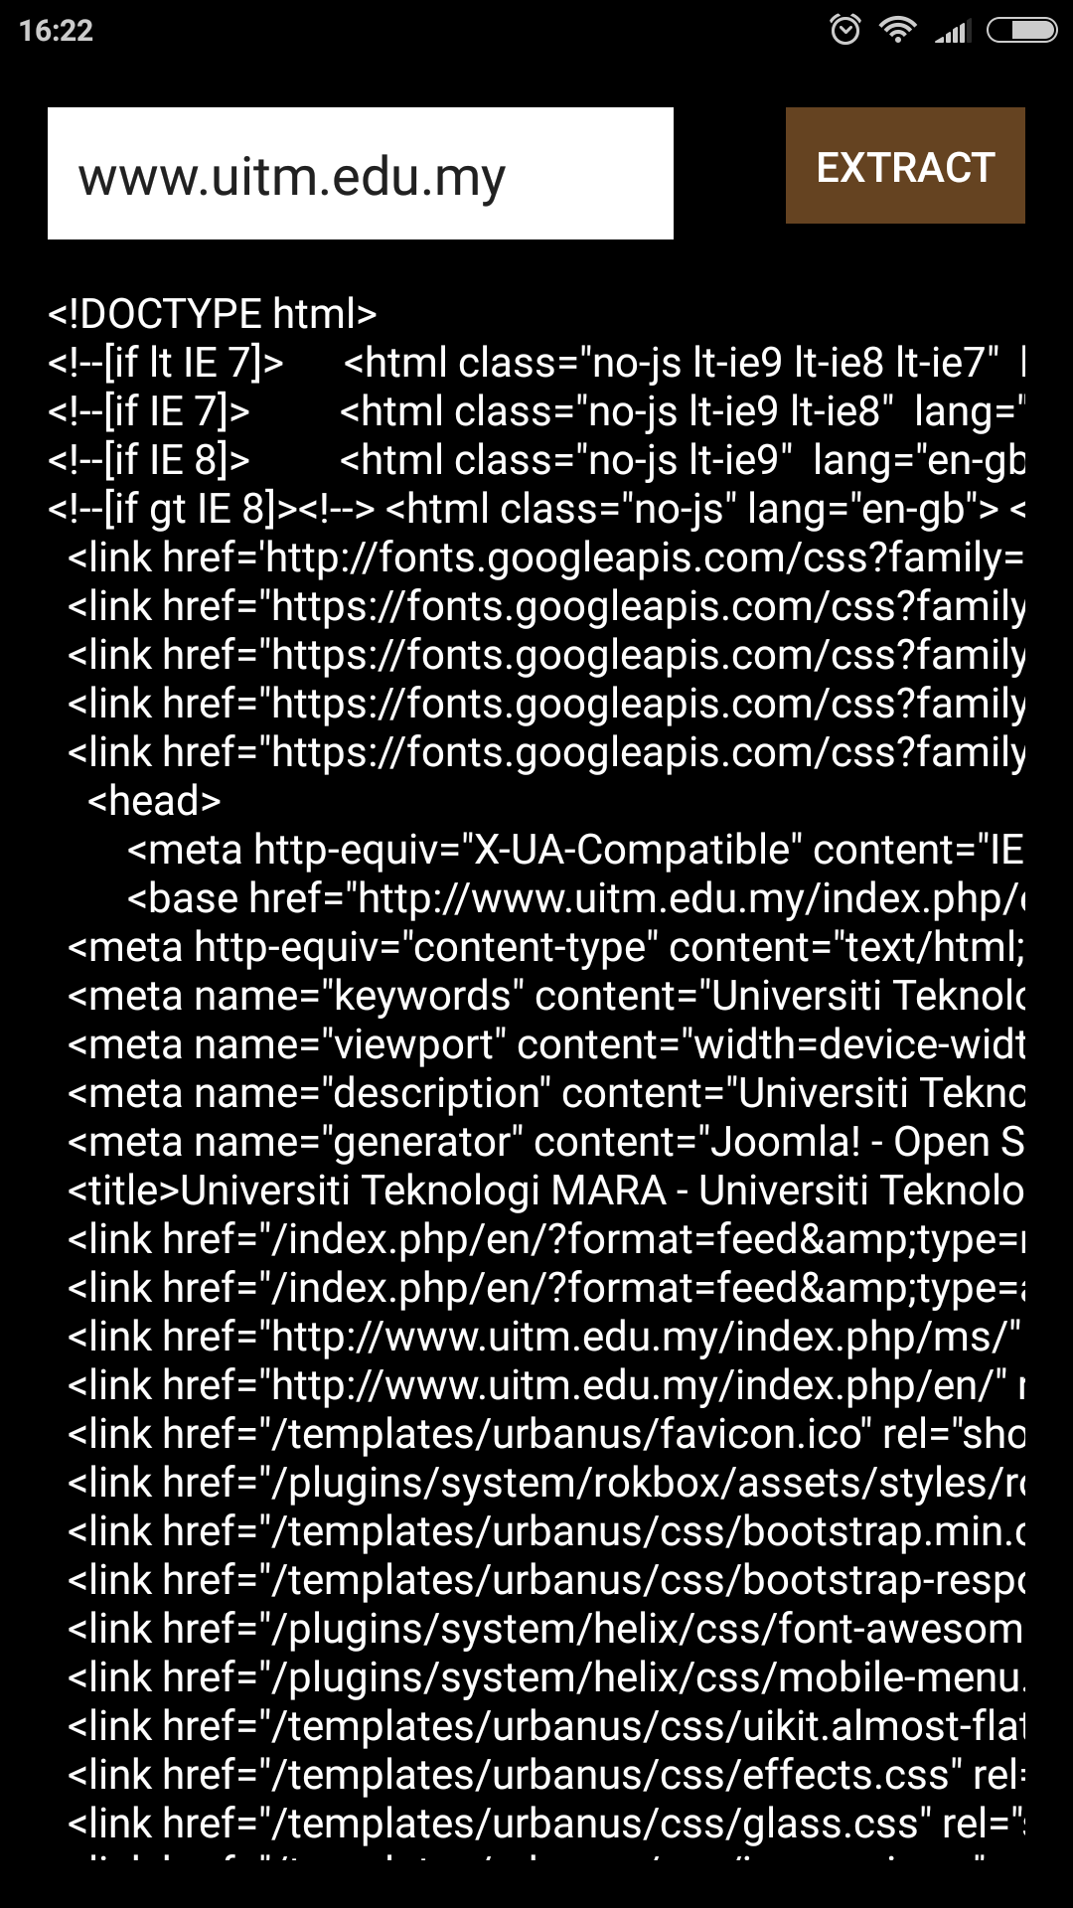
Similar application continue…
Using html parser
Convert http response into string
Disadvantage
Unable to extract data from string

Slide 12
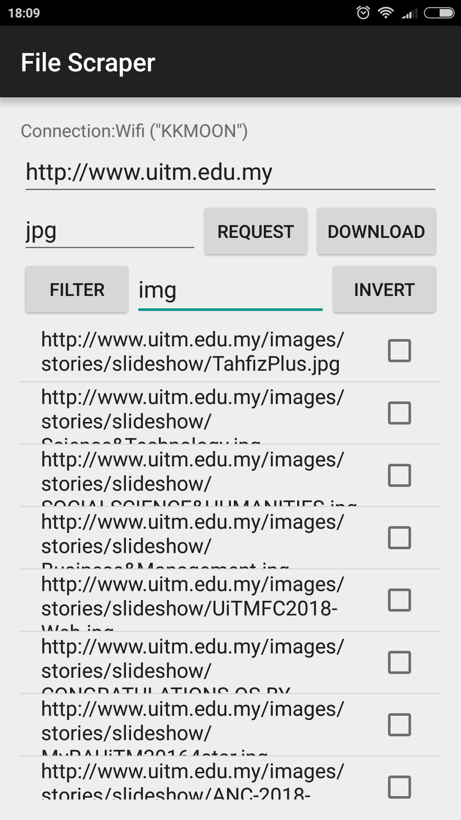
Similar application continue…
Using html parser
Xpath expression
Able to select the node from html document

Slide 13
Comparison
 | HTMLspyll | url extractor | File scraper
Html parser | 1 | 1 | 1
Xpath expression | 0 | 0 | 1
Regular expression | 1 | 0 | 0
Similar app
characteristic

